Slide 1



Machine learning project (AI)

Slide 2
Dataset
Estimation of Obesity Levels Based On Eating Habits and Physical Condition
SPECT Heart
ILPD (Indian Liver Patient Dataset)
AIDS Clinical Trials Group Study 175

Slide 3
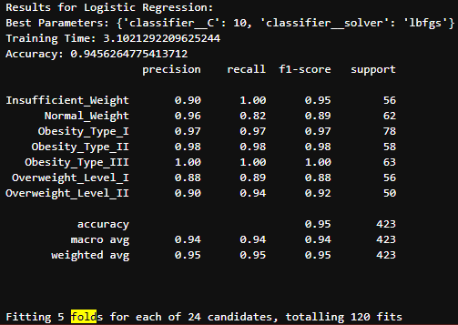
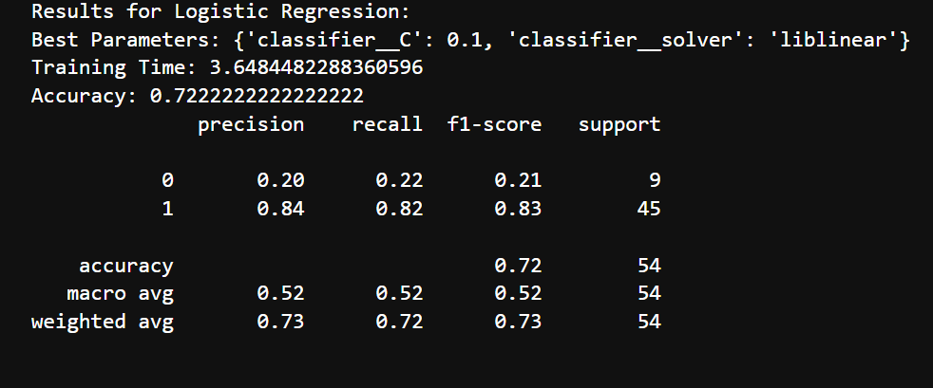
Classification
Logistic regression

Slide 4
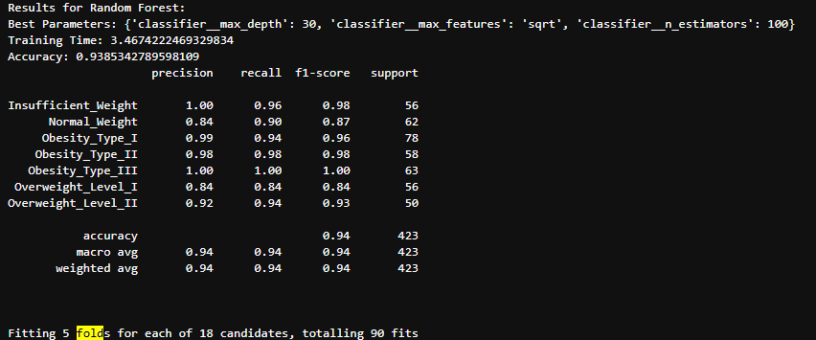
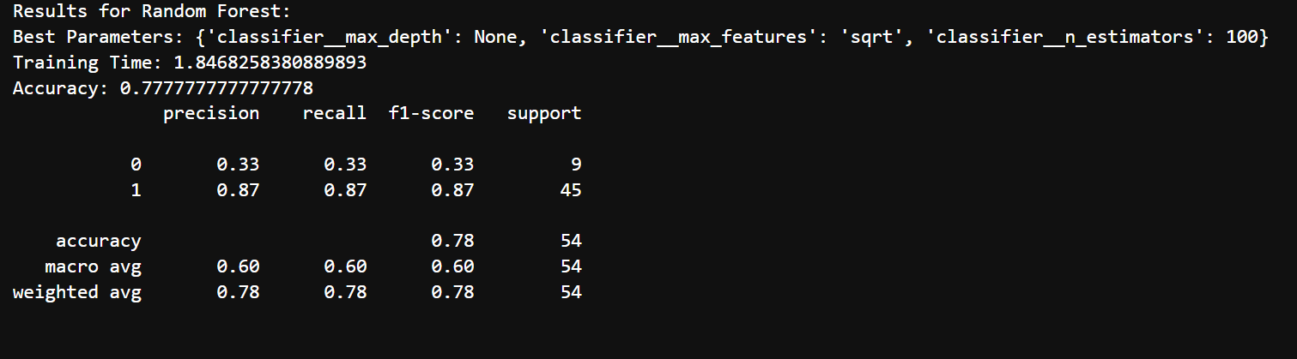
Classification
Random Forest(Ensemble)

Slide 5
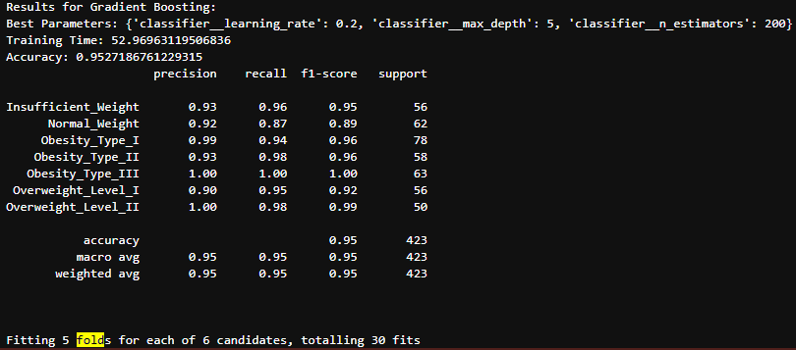
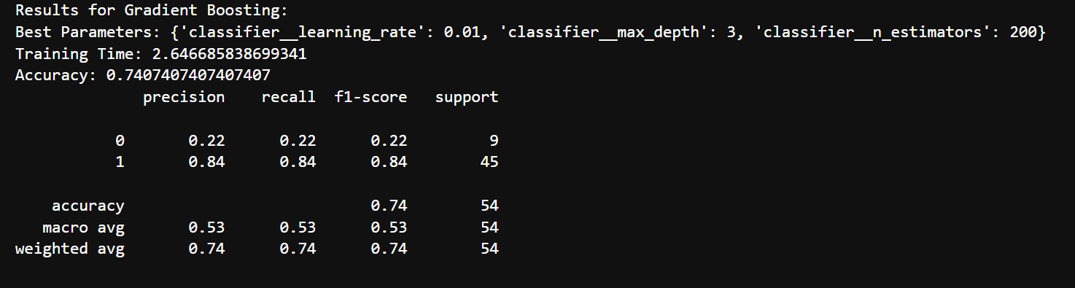
Classification
Gradient Boosting(Ensemble)

Slide 6
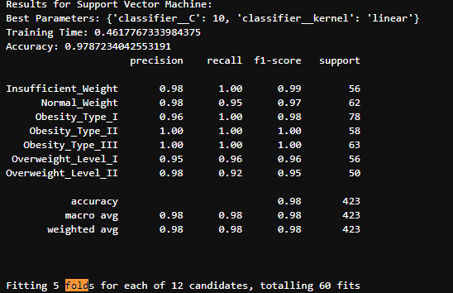
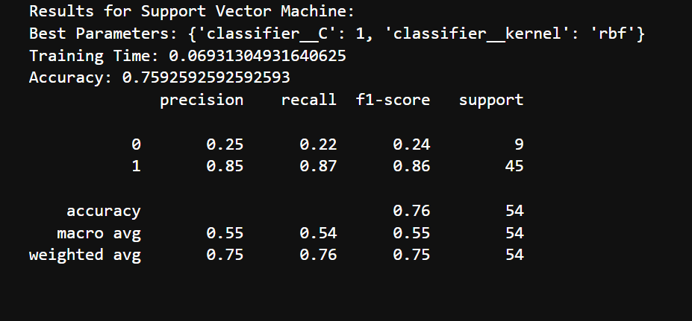
Classification
Support Vector Machine

Slide 7
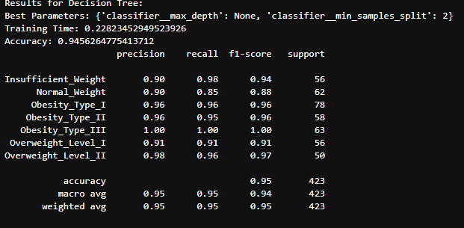
Classification
Decision Tree

Slide 8
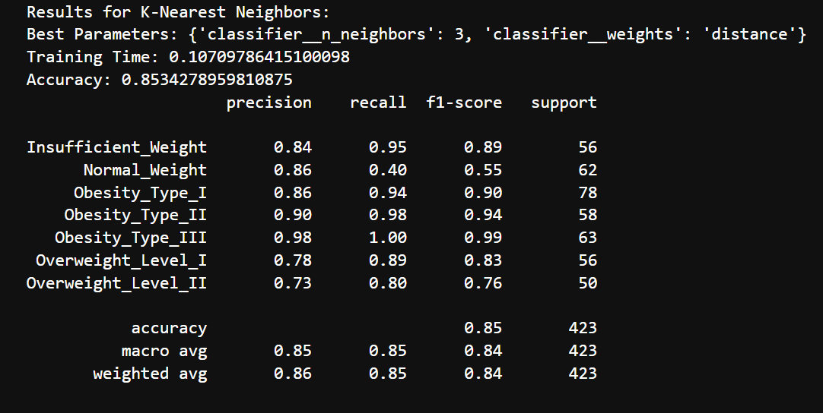
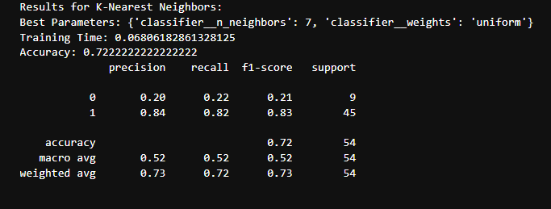
Classification
K-Neighbors Classifier

Slide 9
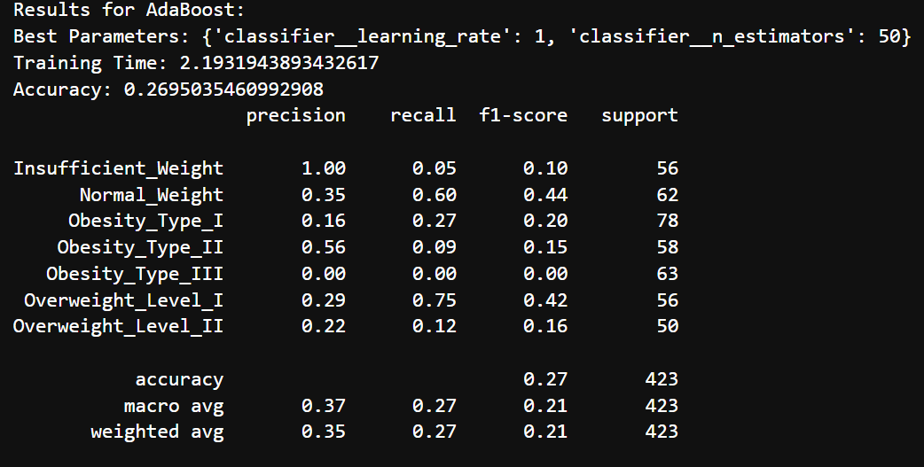
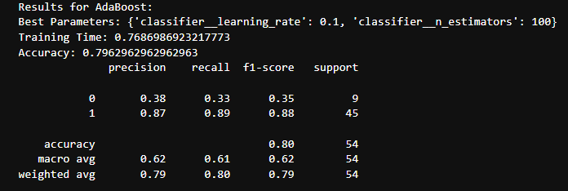
Classification
Aba boost classifier(ensemble)

Slide 10
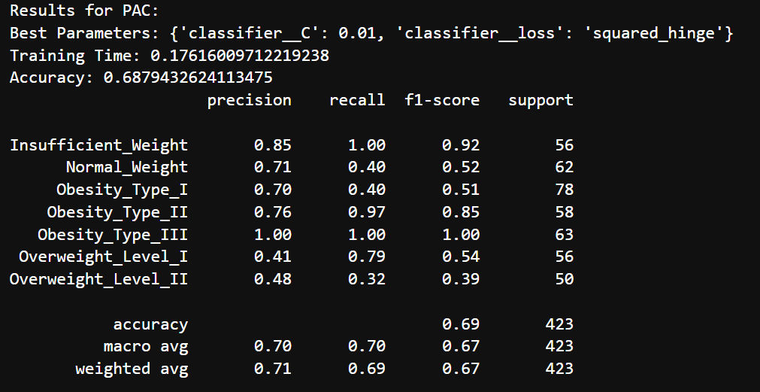
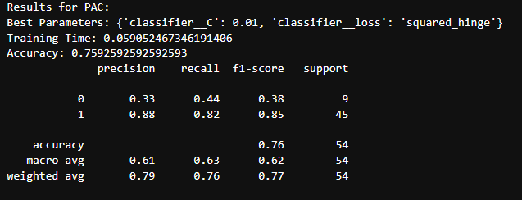
Classification
Passive aggressive Classifier

Slide 11
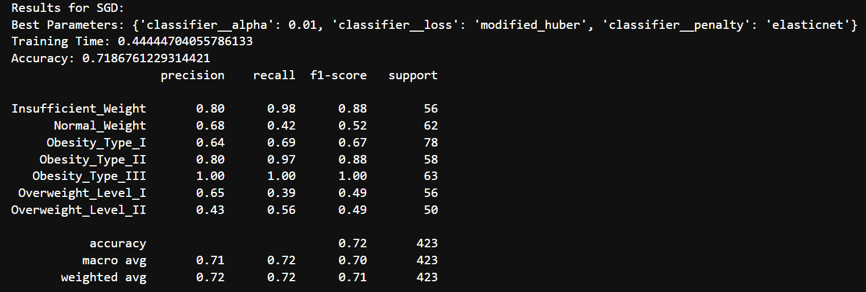
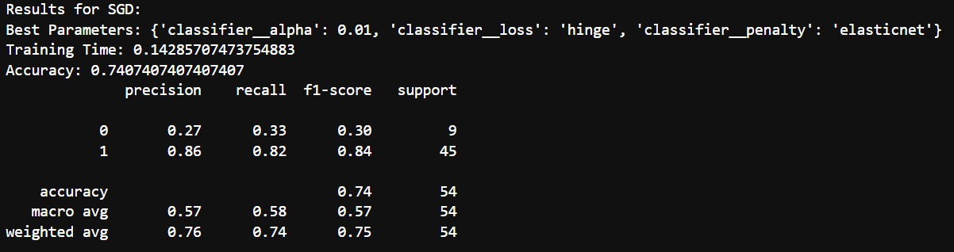
Classification
Stochastic gradient descent classifier

Slide 12
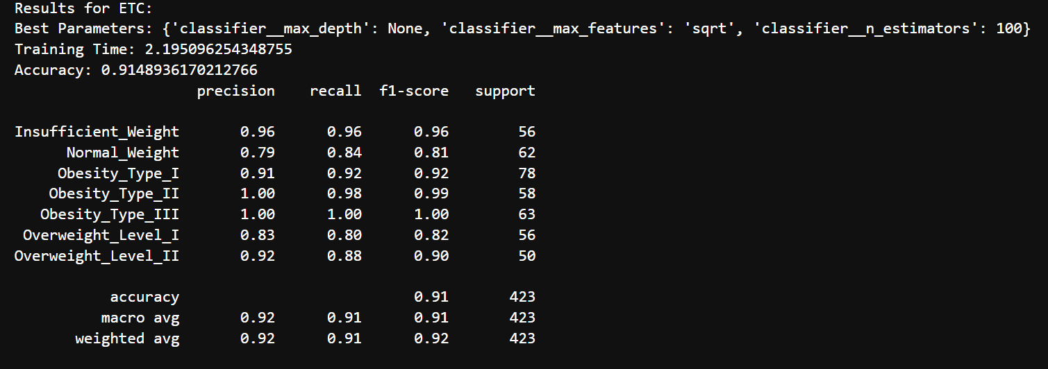
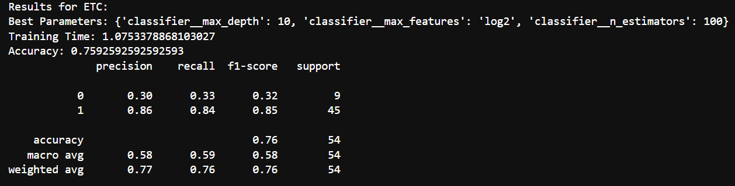
Classification
Extra trees Classifiter

Slide 13
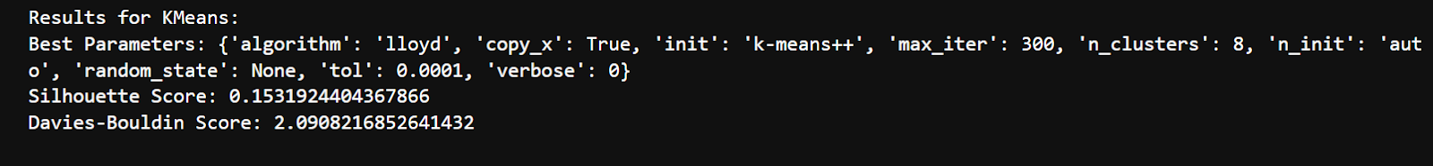
Clustering
Kmean

Slide 14
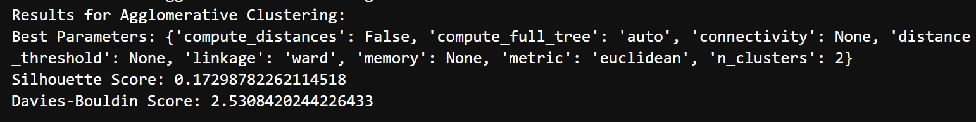
Clustering
AgglomerariveClustering

Slide 15
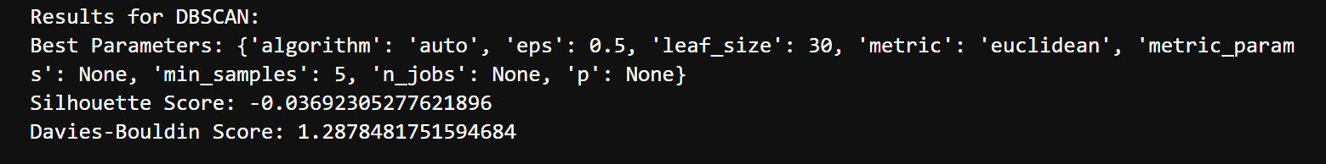
Clustering
DBSCAN

Slide 16
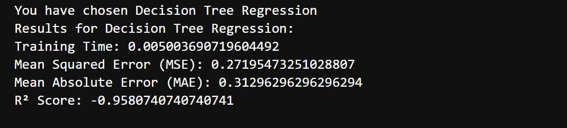
Regression
Decision Tree Regression

Slide 17
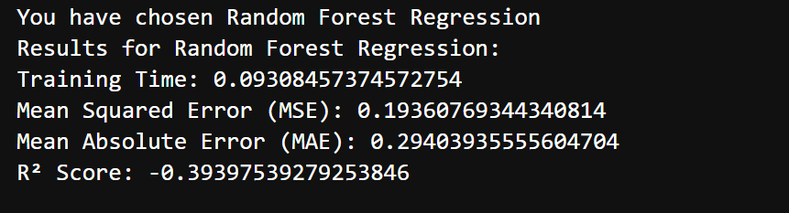
Regression
Random Forest Regression

Slide 18
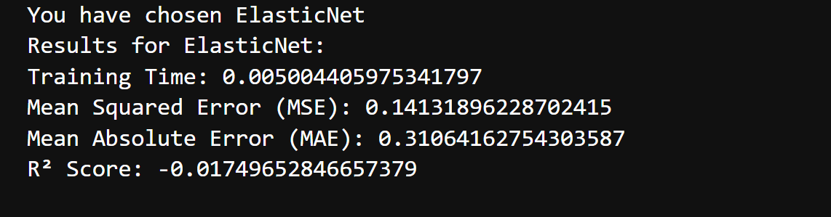
Regression
Elastic net

Slide 19


Validation Process
Hold-out method was used for validation process
80%
Train
20%
test

Slide 20


Hyperparameter tuning
We used gridsearch for choosing the best hyperparameter out of some defined choices the best hyperparameter is listed under each sample run

Slide 21
Model performance

Slide 22
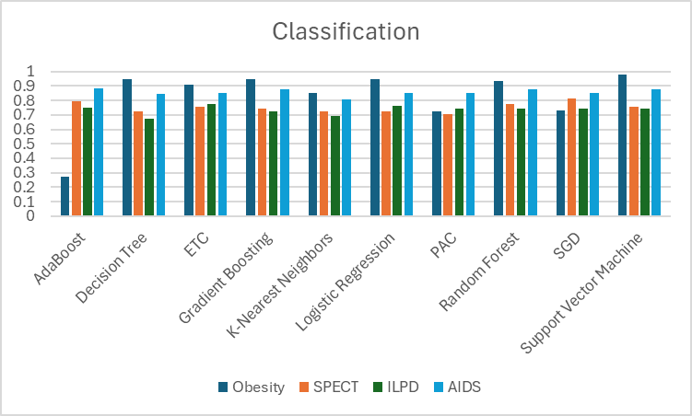
Classification

Slide 23
Thank you for listing

